Slide 1

EDA Project: Bank Loan Default Risk Analysis
Akshay Wanjari

Slide 2
Contents
Introduction
Import Libraries
Data Cleaning
Standardized the Values
Identifying the Outliers
Data Analysis
Categorical Variable Analysis
Plotting the Data

Slide 3
Introduction
This study aims to give an idea of applying EDA in a real business scenario. In this case study, we will develop a basic understanding of risk analytics in banking and financial services and understand how data is used to minimize the risk of losing money while lending to customers.
Risk Associated
If the applicant is likely to repay the loan, then not approving the loan results in a loss of business to the company. If the applicant is not likely to repay the loan, i.e. he/she is likely to default, then approving the loan may lead to a financial loss for the company.

Slide 4

Import Libraries
Pandas
Numpy
Matplotlib
Seaborn

Slide 5
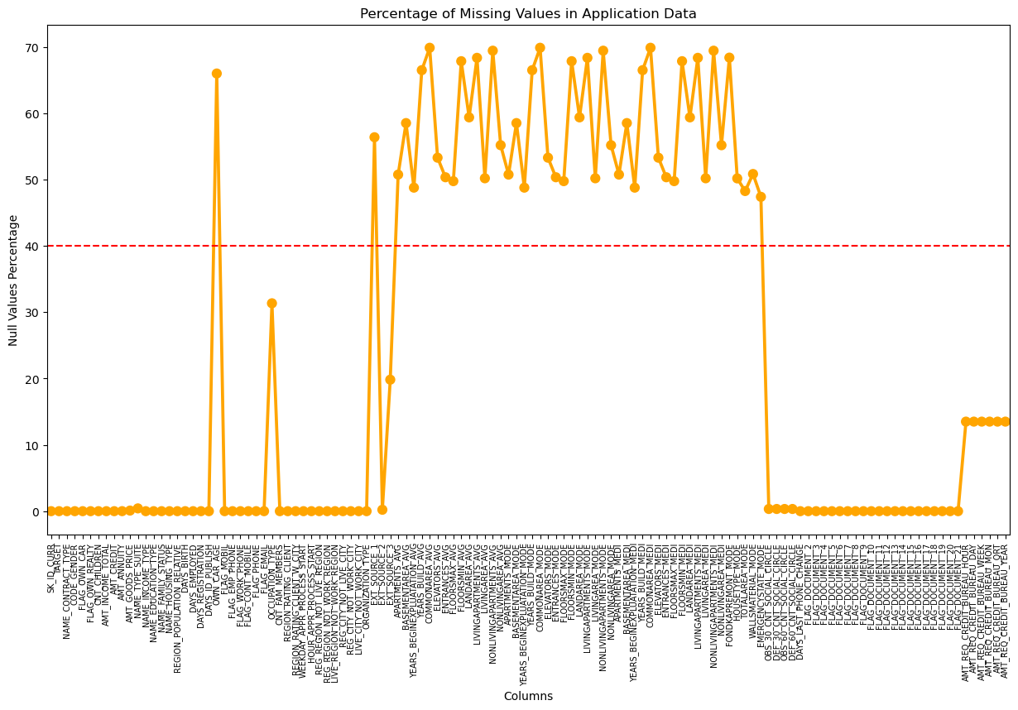
Data Cleaning
From the plot we can see the
columns in which percentage
of null values more than 40%
are marked above the red line
and the columns which have less
than 40 % null values below the
red line. Let's check the columns
which has more than 40% missing
values

Slide 6
Standardized the Values
More than 50% loan applicants
have income amount in the
range of 100K-200K. Almost
92% loan applicants have
income less than 300K
More Than 16% loan applicants have taken loan which amounts to more than 1M.

Slide 7
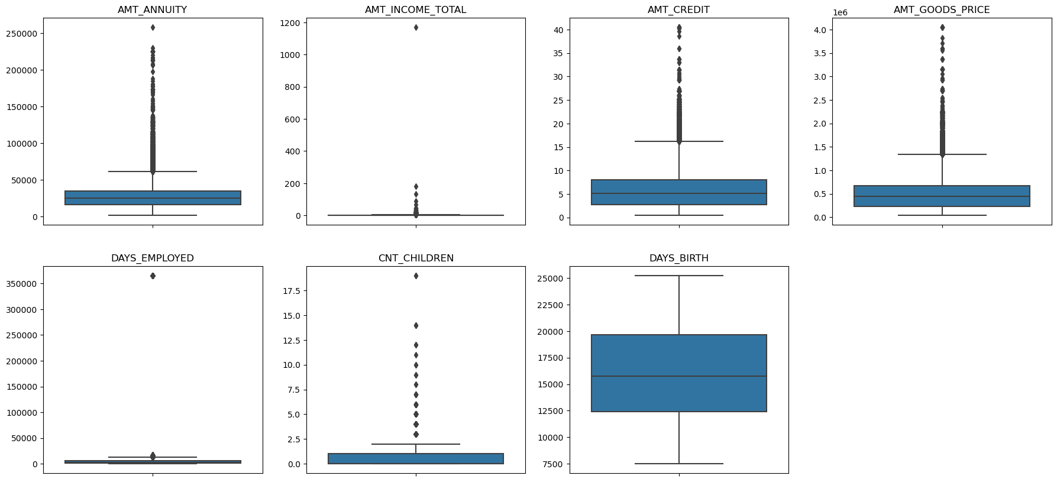
Identifying the Outliers
Few number of outliers:
AMT_ANNUITY, AMT_CREDIT, AMT_GOODS_PRICE,
CNT_CHILDREN
Huge number of outliers due to few of the loan
applicants have high income, compared to the others.
AMT_INCOME_TOTAL
No outliers: DAYS_BIRTH
Outlier values around 350000(days) which is around
958 years which is impossible and hence this has to be
incorrect entry.
DAYS_EMPLOYED

Slide 8
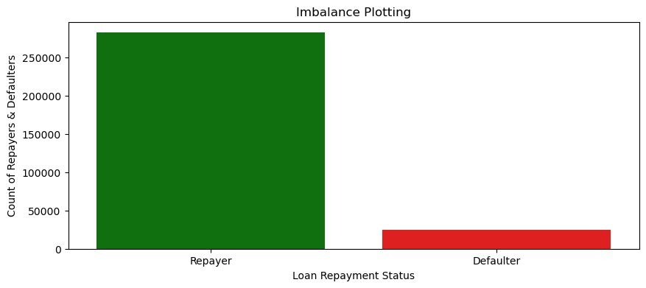
Data Analysis
Ratios of imbalance in percentage with respect to Repayor and Defaulter data’s are: 91.93 and 8.07
Ratios of imbalance in relative with respect to Repayor and Defaulter data’s is 11.39 : 1 (approx.)

Slide 9
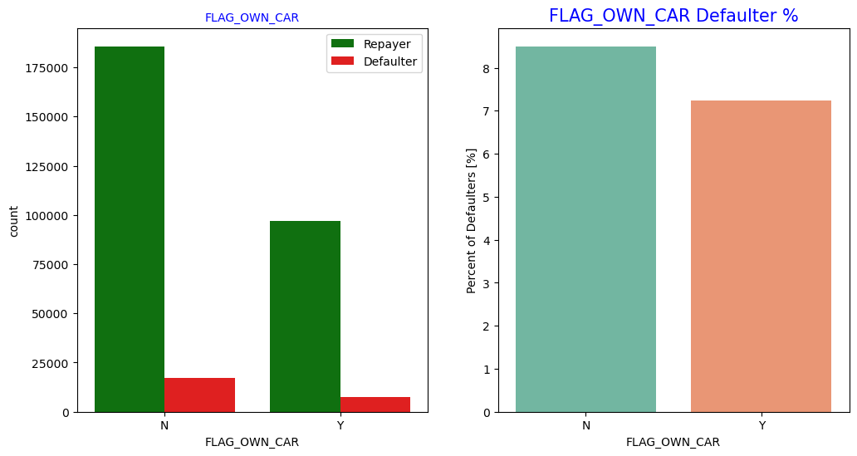
Categorical Variable Analysis
FLAG OWN CAR
No major difference in
Applicant owing a car or not.
In these cases the defaulter’s
percentage is almost same.

Slide 10
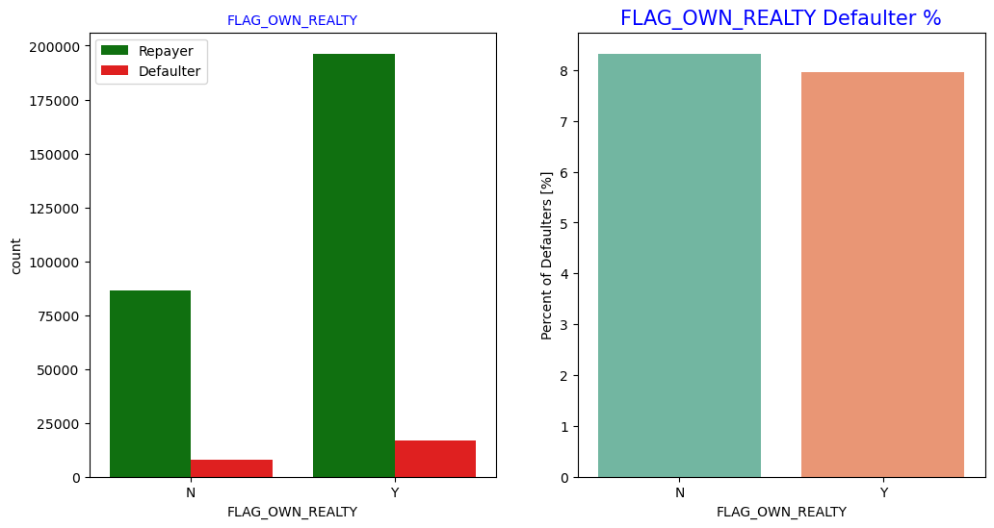
FLAG OWN REALTY
Applicants who own real estate are more than double. But the defaulting rate of both categories are around the same. Hence there is no correlation between owning a realty and defaulter.

Slide 11
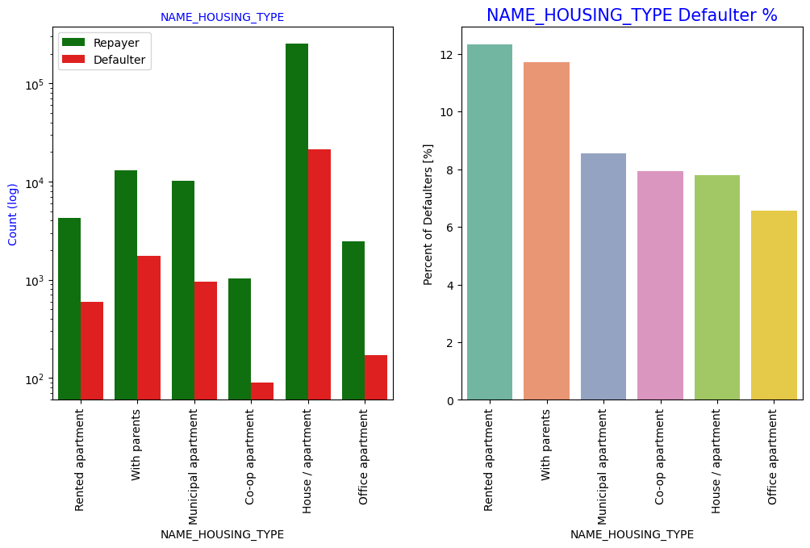
NAME HOUSING TYPE
Most of the people live in Houses/Apartments, People living with parents and in a rented apartments more probability of being defaulters.

Slide 12
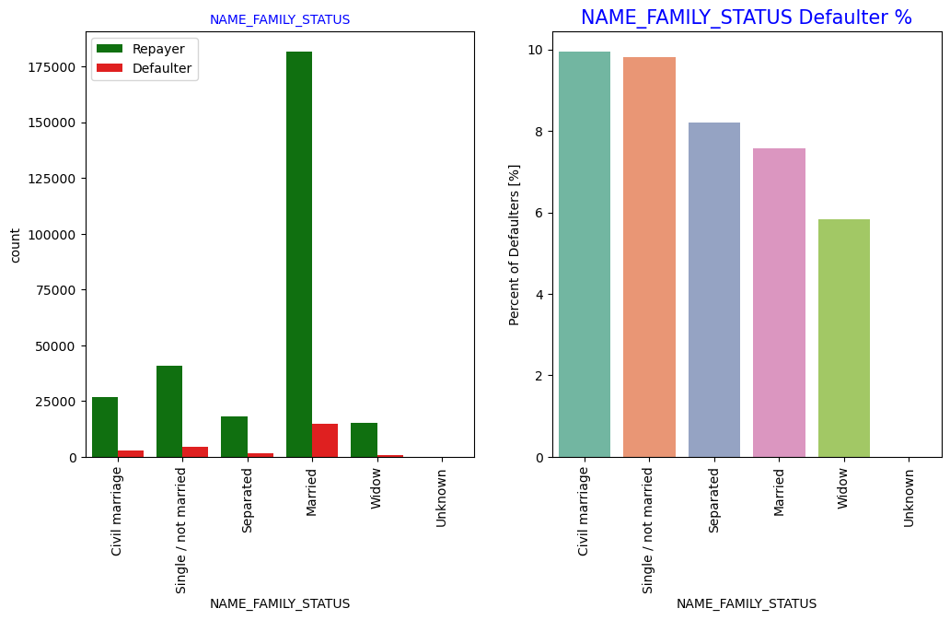
NAME FAMILY STATUS
Married persons has taken loan, In terms of percentage of not repayment of loan, Civil marriage has the highest percent of not repayment, whereas Widow has the lowest percent.

Slide 13
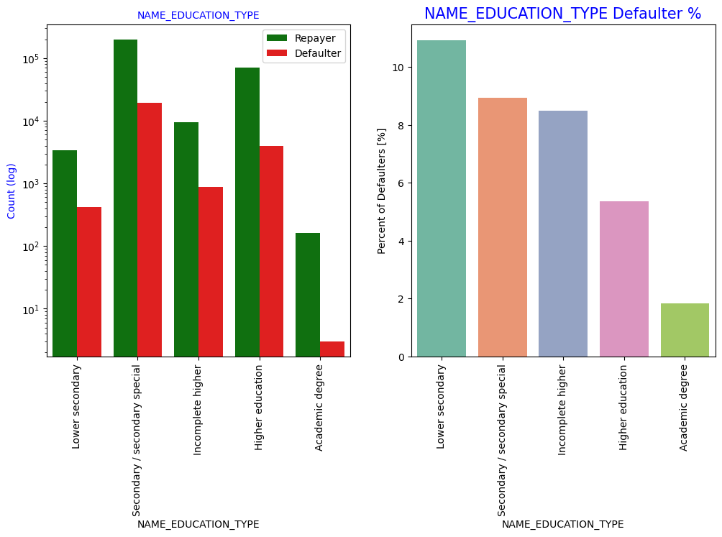
NAME EDUCATION TYPE
Most of the Applicants who has
taken loans have secondary
special education, very less
clients have higher academic
degree. But when we compare
defaulters lower secondary has
the highest percentage of
defaulters as compared to others
whereas academic degree have
lowest defaulting rate.

Slide 14
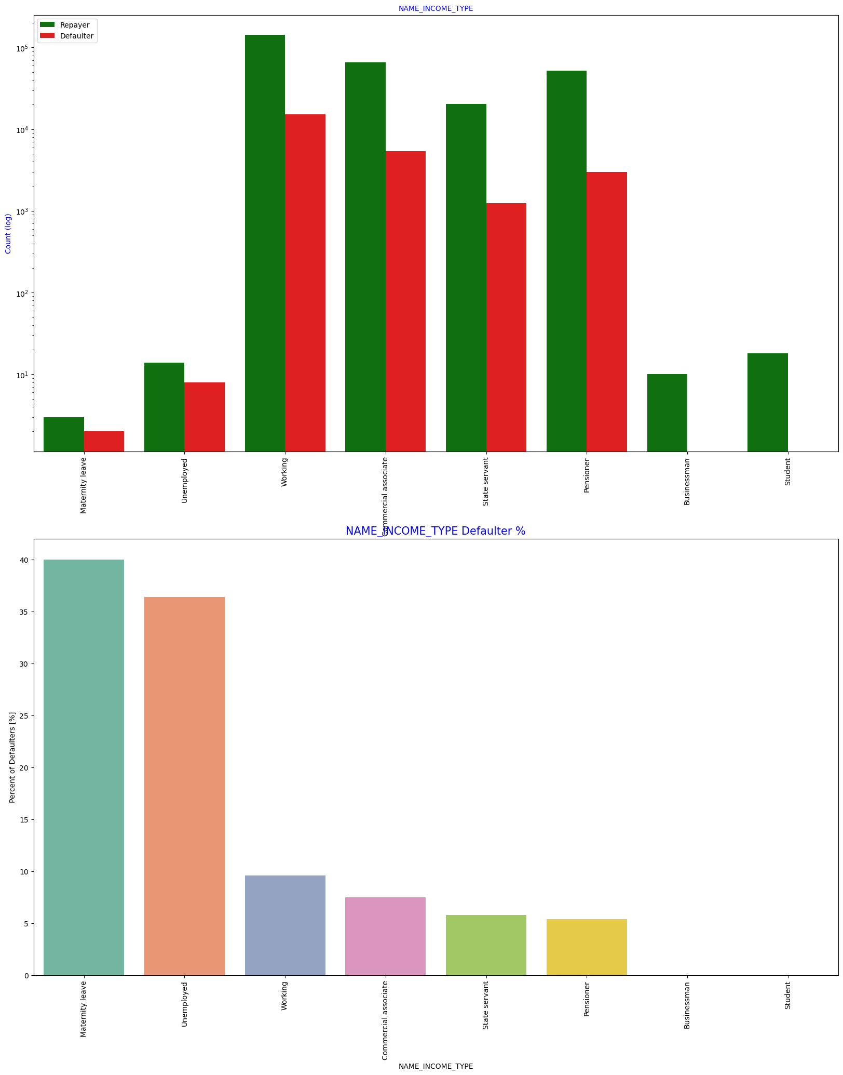
NAME INCOME TYPE
Mostly applicants are working, followed by Commercial associate, Pensioner and State servant. Applicants having income type maternity leave and unemployed applicants have more defaulting rate, whereas businessmen's and students don’t have any default record.

Slide 15
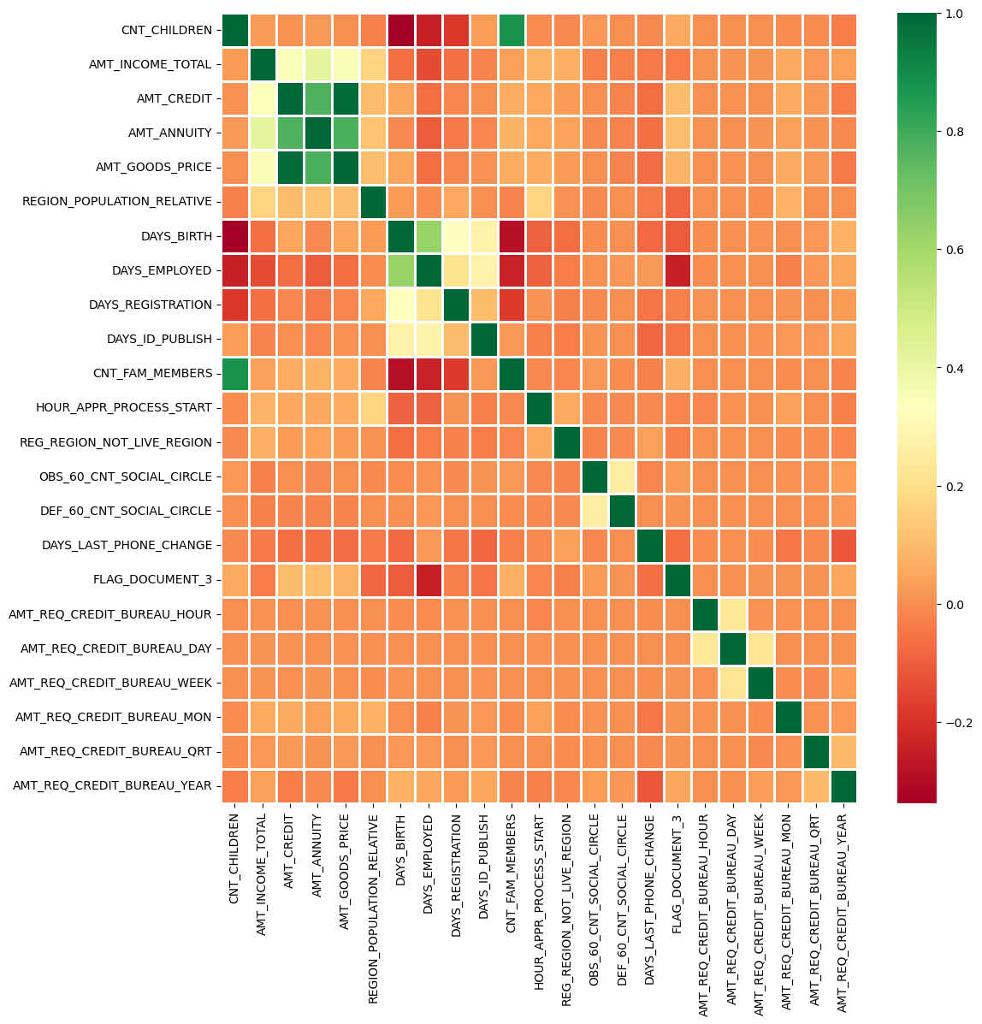
CORRELATION WITH REPAYER DATA
As we can see that there is no correlation between all the variables with repaying credit amount. But Credit amount is highly correlated with amount of goods price, loan annuity, total income

Slide 16
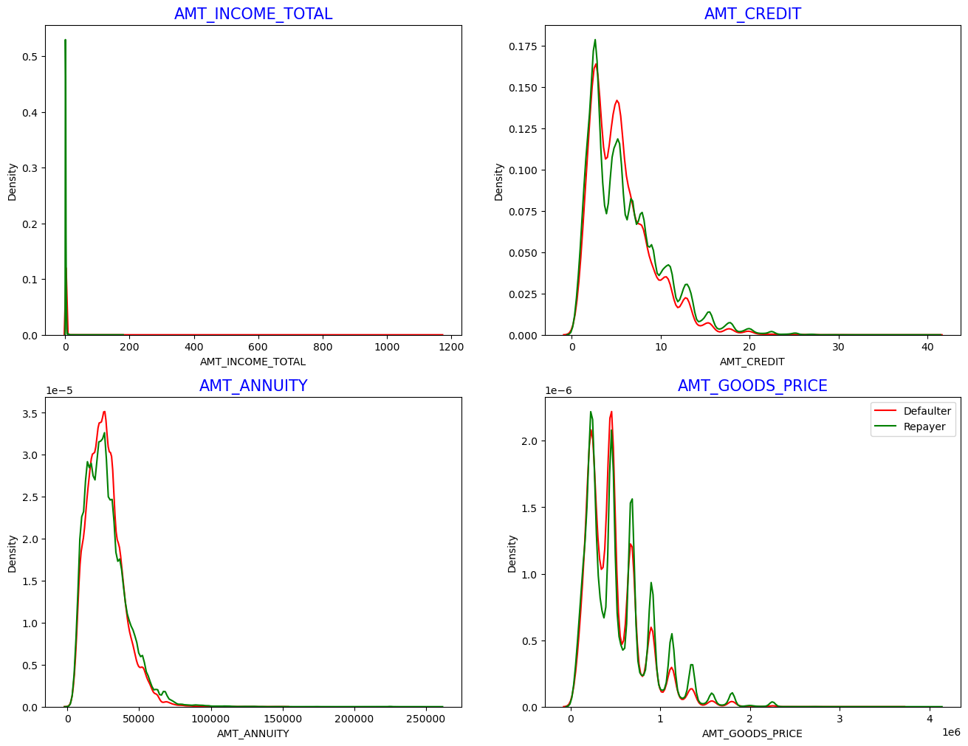
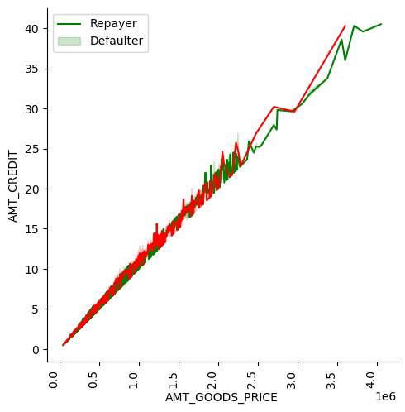
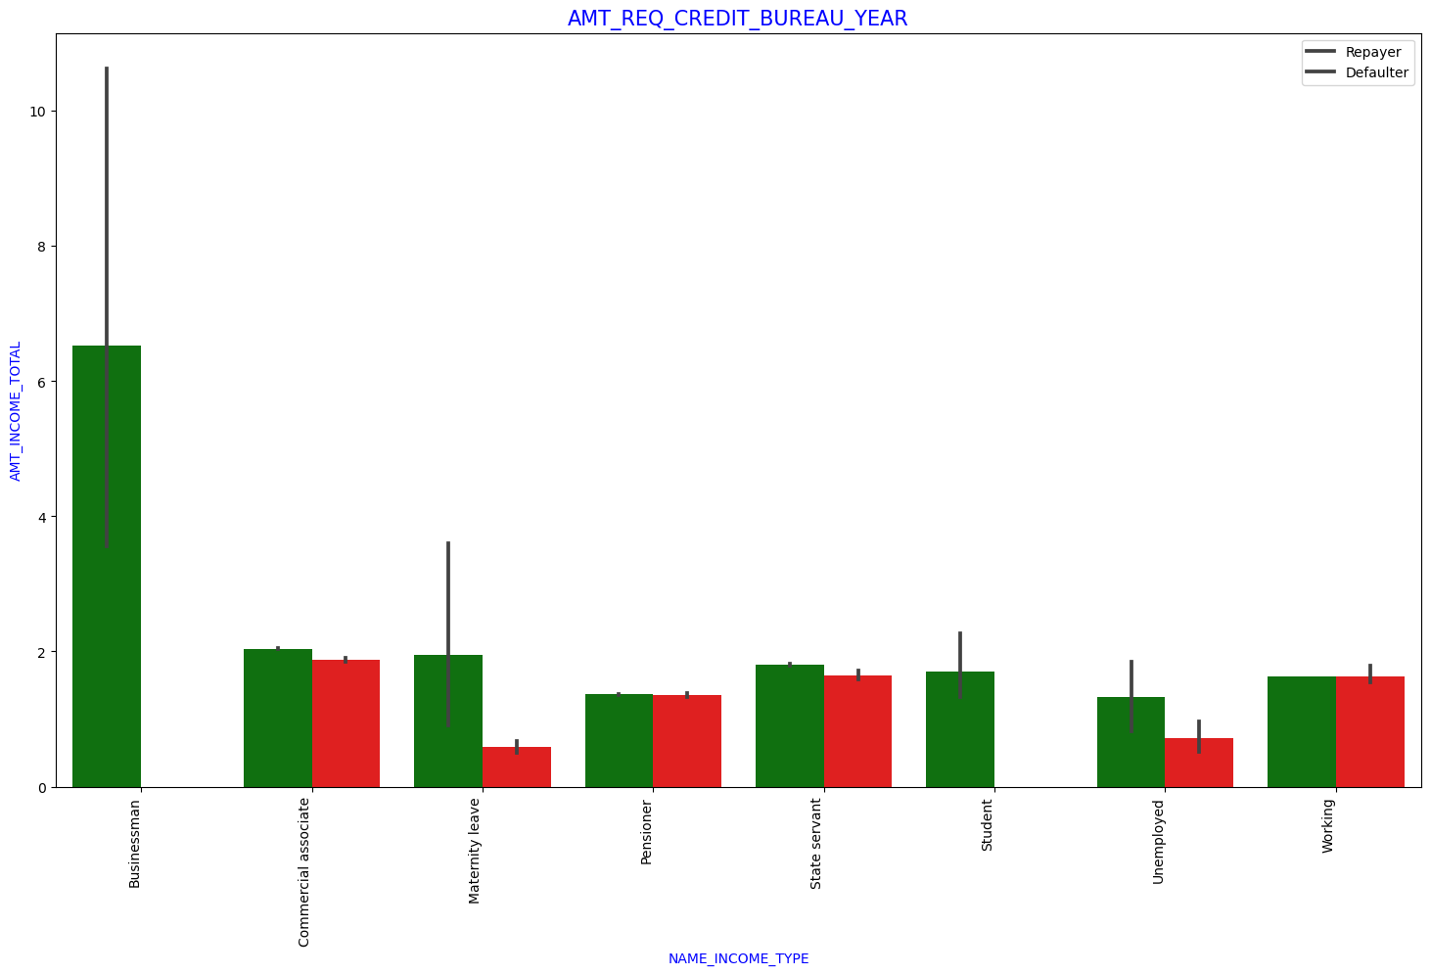

Slide 17
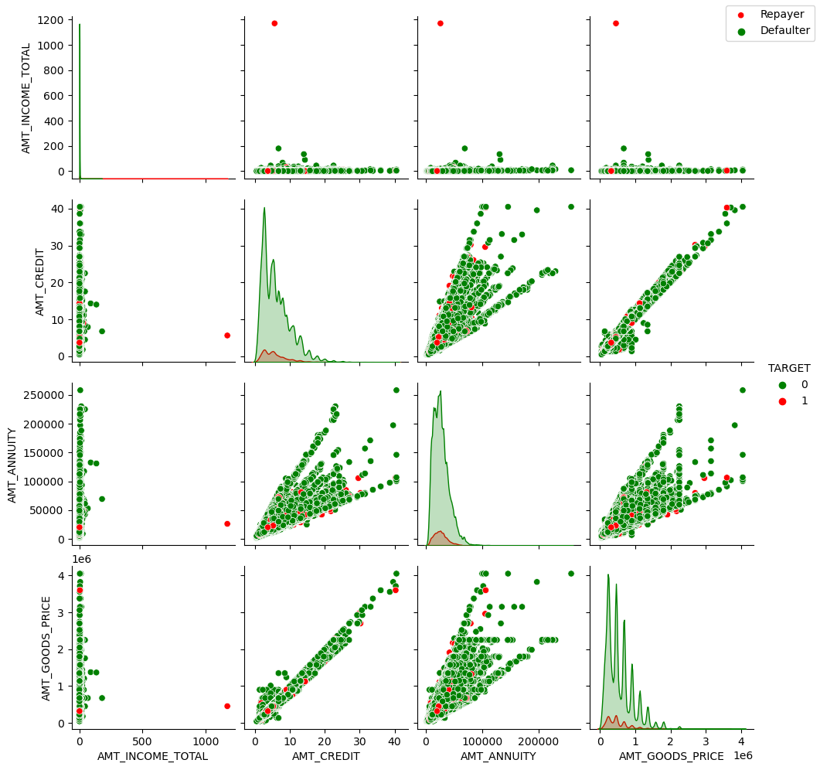
AMT_CREDIT and AMT_GOODS_PRICE are highly correlated as based on the scatterplot where most of the data are consolidated in form of a line
AMT_GOODS_PRICE is correlated
with AMT_ANNUITY.

Slide 18
Thank You

